Slide 1


#CODE19INDIA
Prototype Submission Phase

Slide 2
TEAM NAME and MEMBER DETAILS
Name | Dept | College | Year | Mail id
Krupha C M | CSE | Sri Sairam Institute Of Technology | II | mimkrupha@gmail.com
Nikhil R | CSE | Sri Sairam Institute Of Technology | II | nikhilragha@gmail.com
Rithika M S | CSE | Sri Sairam Institute Of Technology | II | rithika14jo@gmail.com
Shanmuga raja rajeswaran M | CSE | Sri Sairam Institute Of Technology | II | msrrw1431@gmail.com
Maheswari G | CSE | Sri Sairam Institute Of Technology | II | dhandusat@gmail.com
Kruthiga P N | CSE | Sri Sairam Institute Of Technology | II | kruthinaren29120@gmail.com
Sriram | CSE | Sri Sairam Institute Of Technology | II | m.srirammadhi@gmail.com
THEME:
Open Innovation for Covid-19

Slide 3
PROBLEM STATEMENT
Covid-19 is the recent most deadliest virus that causes several death across the world. Here we have the idea based on this virus prevention ,safety measures etc.
Most of the peoples are not aware of the covid -19 and its impact , so in order to create awareness and do know that they are affected by the virus.
Our idea is to develop an android application to face the current situation problem and also our app contains chatbot which allows user to find the symptoms and steps he/she must do before or after affected by virus.

Slide 4
SOLUTION
The application is mainly for updating people about covid-19 and creating awareness. It contains online nearest shop purchasing facilities, medical facilities.
Our government many motto is not to go out and stay home ,so we added a this features so they can call and place their orders and free delivery or paid delivery will be available in those shops.
Apart from this , the educational help is also done. The students studying 10th and college student may be in need of the study materials .so connecting and give them the right notes will also an additional features in this application.

Slide 5
SOLUTION
The webpage is mainly for updating people about covid-19 and creating awareness. It contains online nearest shop purchasing facilities, medical facilities.
Our government many motto is not to go out and stay home ,so we added a this features so they can call and place their orders and free delivery or paid delivery will be available in those shops.
Apart from this , the educational help is also done. The students studying 10th and college student may be in need of the study materials .so connecting and give them the right notes will also an additional features in this webpage.

Slide 6
SOLUTION
Next thing is that recent updates and world wide covid-19 updates will be given .various health and medical tips also given.
User can also provides help by offering food and fund to the needy . they can know the details and give them the needs. User can post their needs or others needs in this application and send this and collect the fund
This also contains PM or respective state CM funding links too. Users can also give their own suggestion and medical doctors can give suggestion in the tips section too.

Slide 7
SOLUTION
Tools/Technologies used
PYTHON
HTML
CSS
It has following facilities:
Donate
Entertainment Zone
Education
E-commerce facilities
Medical
Knowledge transfer
Chatbot
Queries

Slide 8
SOLUTION
Assumptions, constraints, and solution decision points:
Allows user to be updated and to check his/her health by chatbot conversation . Gives only true information and answers to questions based on WHO.
This is effective and right app for user to get all information within this application which are updated and .
Extent of Scalability/Usability(Effectiveness) :
Only requiremnet for user to operate this app is internet .
This connect various facilities and give a common platform for all requirements.
User can access this at any time (24*7 ).

Slide 9
SOLUTION
So let me compare this app with aryogaya setu (official indian government app)
Anti-covid | Aarogya setu
Gives updates worldwide and also health and medical tips. | Gives update only on India and also provide health tips.
Provides various facilities like games ,study materials , E-learning ,updates , Chatbot. | Provides only chatbot and preventive tips and FAQs
various schemes details , also donating facilities , preventive tips from WHO | Only covid details.
It has E-commerce facilities | No facilities like this
It can used by people all over the world. | Can be used by indians only
It also have knowledge transfer part where user can share their solutions to the others | No facility like this.

Slide 10
METHODOLOGY
Link:
Detailed explanation of project
https://drive.google.com/file/d/1hqUKPqUD8-tkYO_zbta5NEkq0woKFO42/view

Slide 11
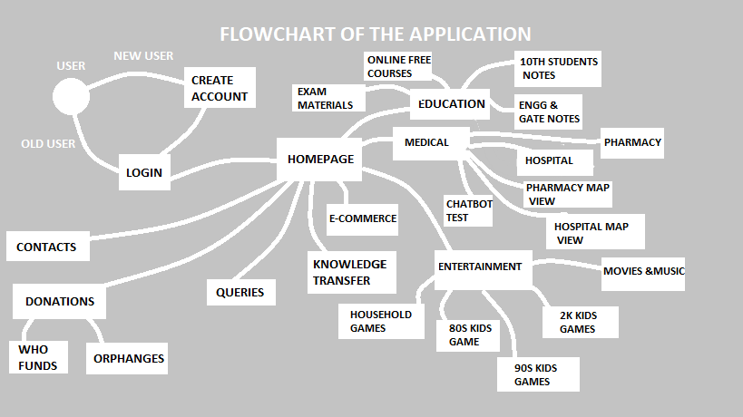
METHODOLOGY

Slide 12
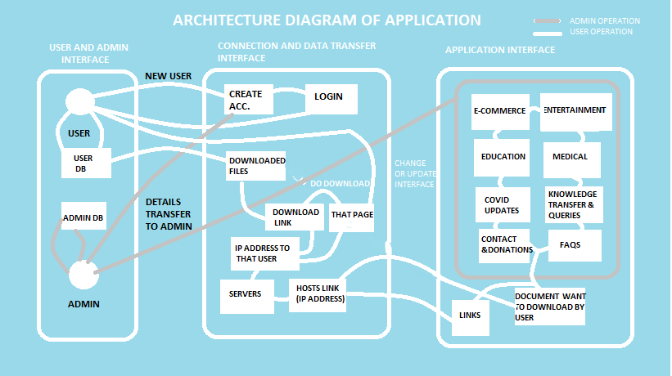
METHODOLOGY

Slide 13
WORKING PROTOTYPE
DOWNLOAD LINK FOR OUR WORKING PROTOTYPE:
https://appsgeyser.io/10618694/Anti%20Covid

Slide 14
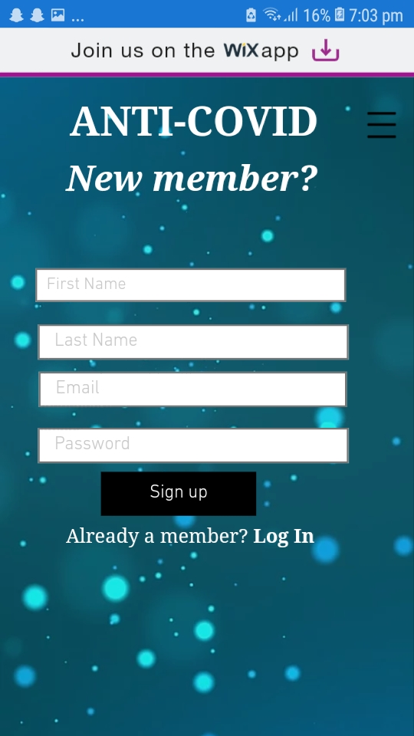

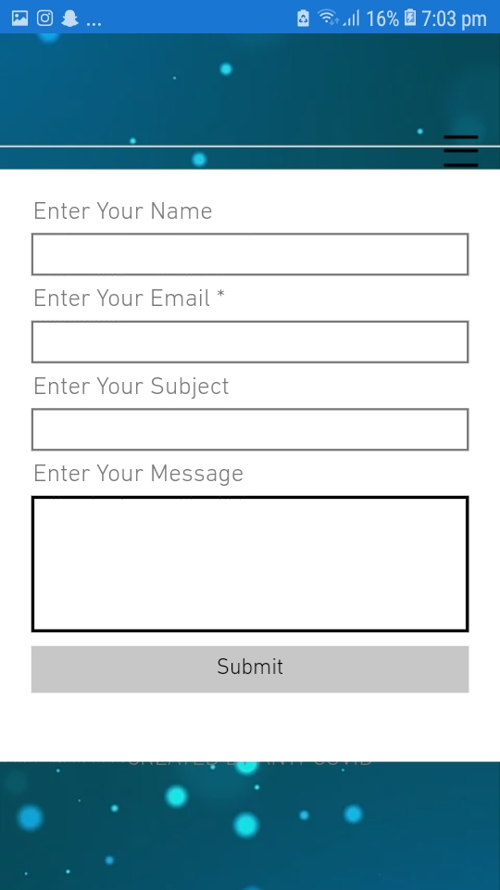
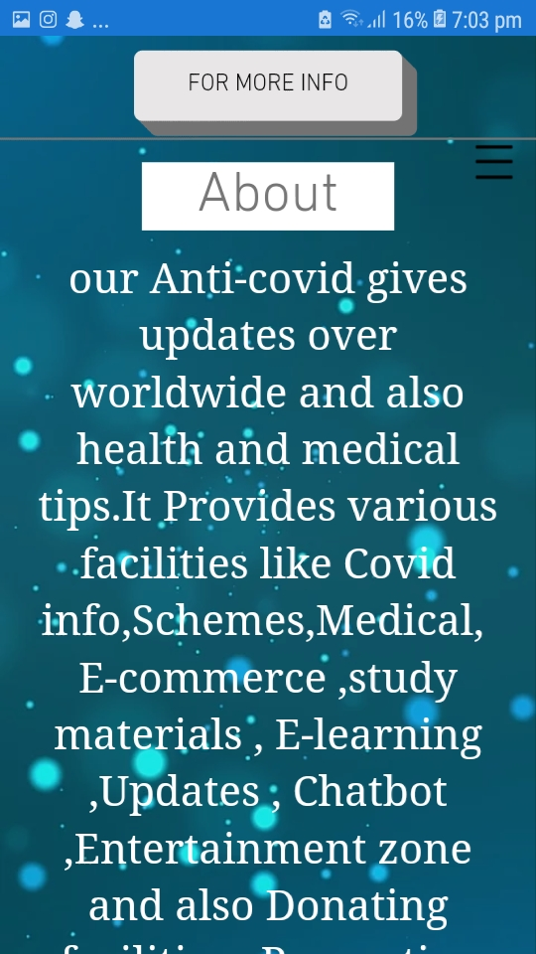
ATTACHMENTS

Slide 15
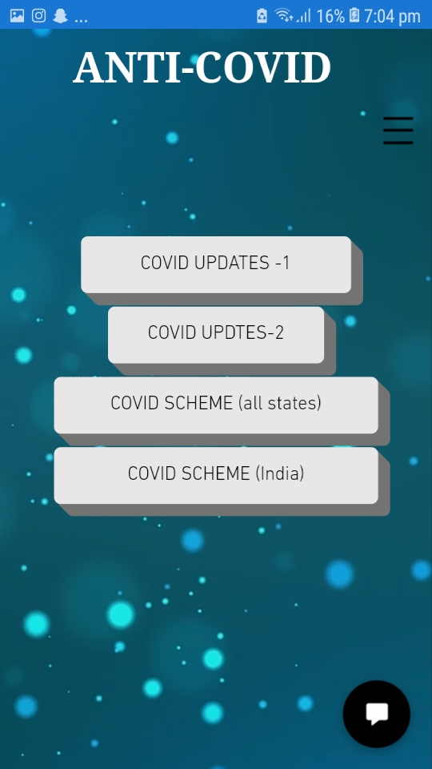
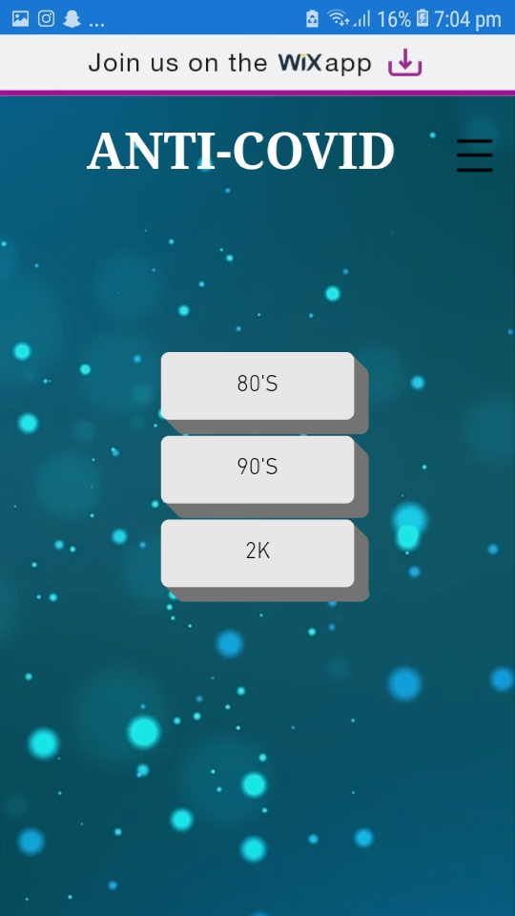
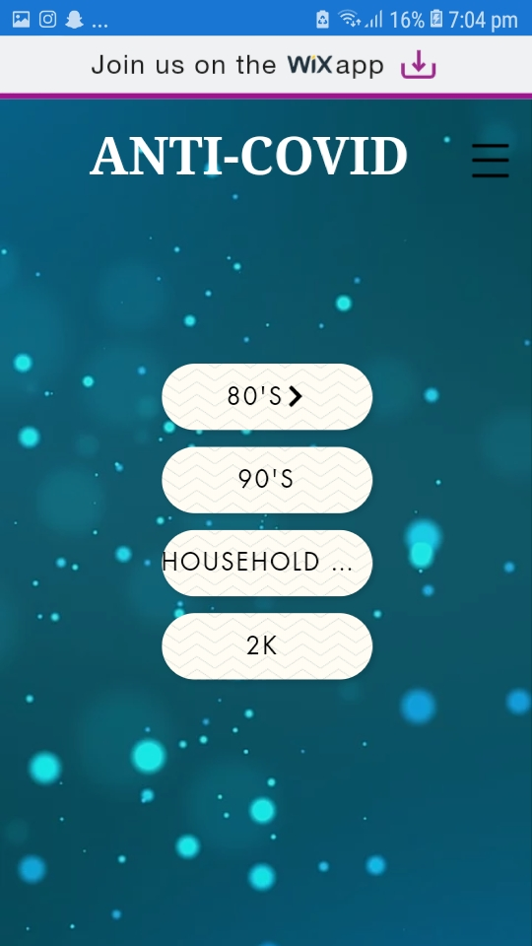
ATTACHMENTS

Slide 16
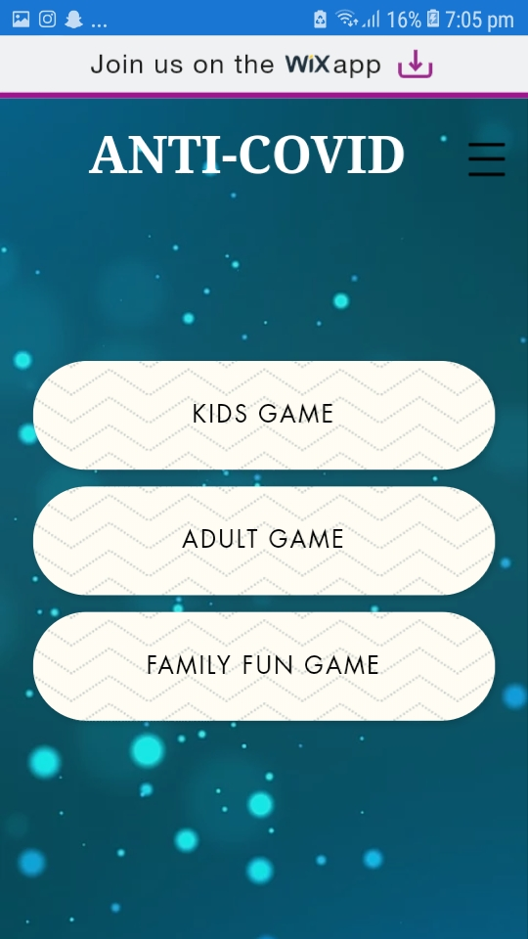
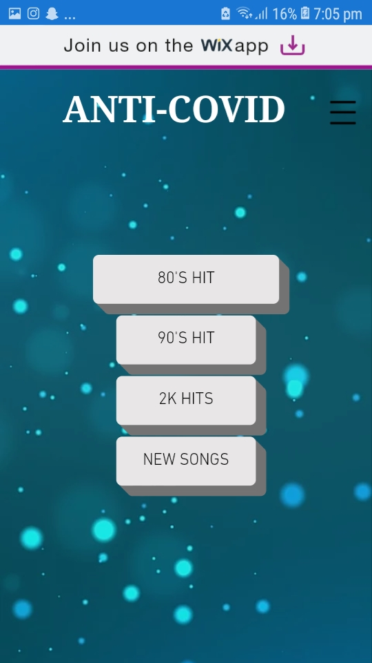
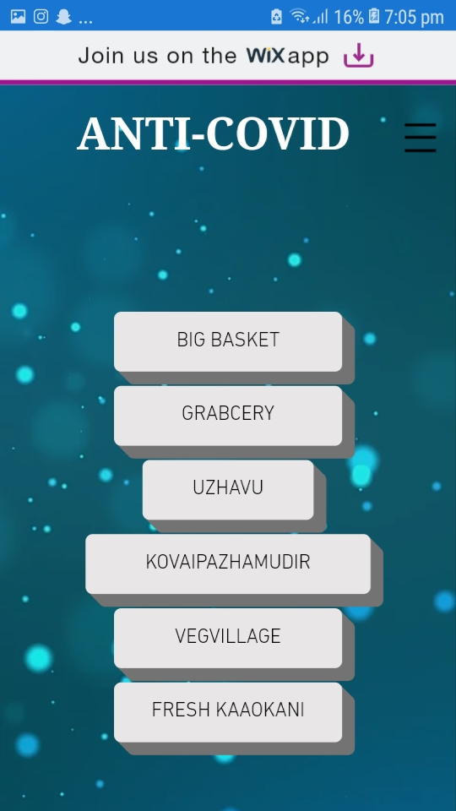
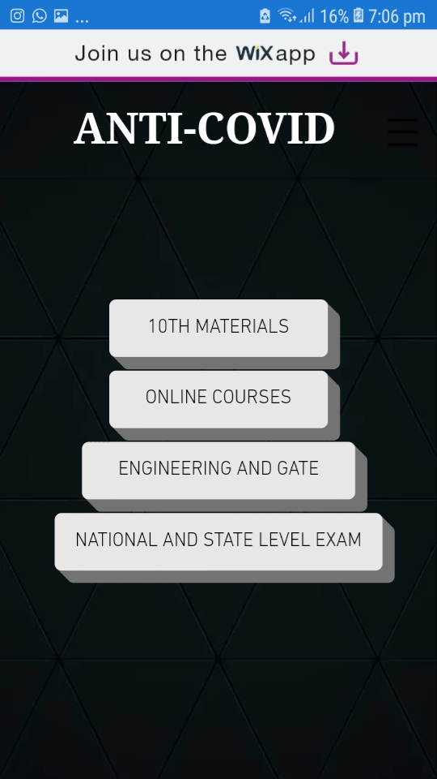
ATTACHMENTS

Slide 17
SOCIETAL IMPACT/ NOVELTY
FUTURE SCOPE
> Once it is implemented people got no reason to go out and get their needs with a call.
> This also provides entertaining online and offline games , online free courses websites , donating websites , studying materials websites and covid updates.
>This provides various scheme information which are implemented for covid .
> This provides FAQ answer according to WHO and contains health and preventive tips given at corona virus pandemic.
This helps shops owner to improve their facilities for people and medical shops are also connected.
This helps the user to spend time at home and to break the chain of spreading.
Additional features like emergency cases call and police helpline are future enchancements of this app.

Slide 18
THANK YOU
#CODE19INDIA

